Slide 1

Budget Sales Analytics
Zeeshan Khan

Slide 2
Agenda
Project Details
Objectives
Problem Statement
Process Flow
Insights
Designed Visuals
Conclusion

Slide 3
Project Details
Technology | Data Science
Domain | Retail & Sales
Project Level | Advanced
Programming Language Used | Python, R Scripting
Tools/ Libraries used | Kaggle, MS-Excel, PowerBI, NumPy, Pandas, Matplotlib, Seaborn.

Slide 4
Objectives
Analyze Sales Trends: Evaluate sales performance, revenue, and transaction values over time.
Customer Segmentation: Identify and segment customers by demographics, behavior, and location.
Product Analysis: Assess domain popularity and pricing to optimize sales.
Budget Comparison: Compare budgeted goals with actual sales to identify and address variances..

Slide 5
Problem Statement
Our domain sale process enables immediate purchasing without direct seller contact. Sellers list domains with specified prices in our Marketplace. Interested buyers can view and purchase listed domains. Extract sales, budget, and variance data, comparing them across various attributes.
Analyze product details and customer demographics. Create a comprehensive dashboard with visualizations to highlight key metrics and relationships between sales, customer behavior, and product performance.

Slide 6
Process Flow
Data Exploration & Analysis
Analyzing the data visuals on Power Bi
Design Visualizations
Presenting the final conclusions
Data Collection
Data Cleaning & Preparation

Slide 7
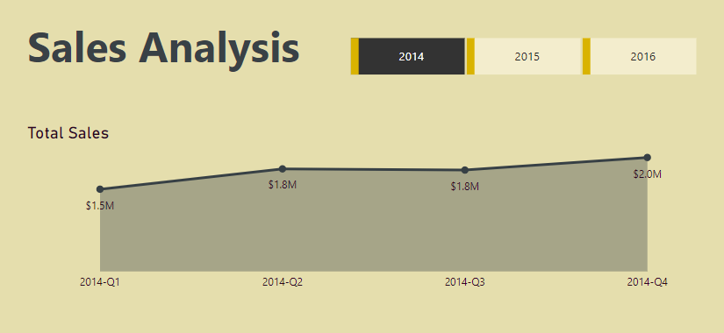
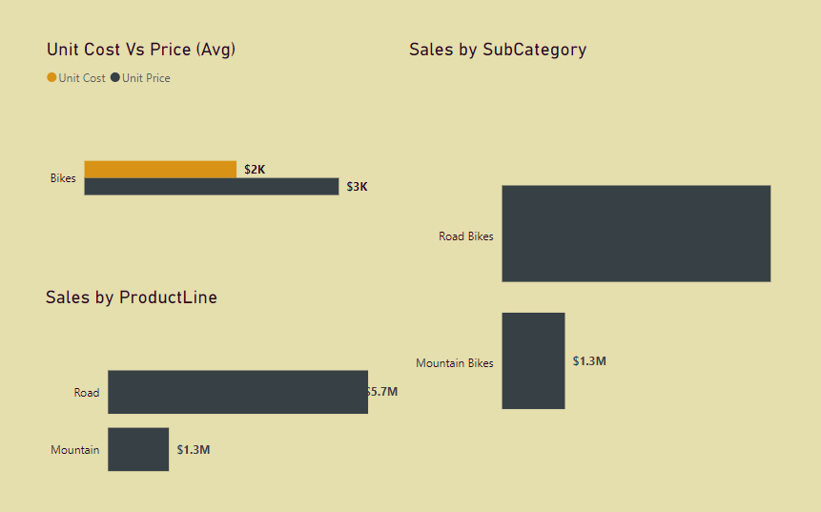
Insights
Total Sales appear to be increasing year-over-year. In 2014, total sales were $51.5 million. There is no data beyond 2014 for total sales, so it is impossible to say for sure if this trend continued.
Sales by Product Line show that Academy Bikes is the top seller, followed by Mountain Bikes. In 2014, Academy Bikes sold $5.7 million and Mountain Bikes sold $1.3 million.
Australia appears to be the most profitable region. In all three years (2014, 2015 and 2016), Australia has the highest profit contribution percentage. Their profit contribution went from 36.60% in 2014 to 40.55% in 2016.
Profit margins seem to be consistent across all regions. There is slight variation year over year, but overall profit margins hover around 40%.

Slide 8
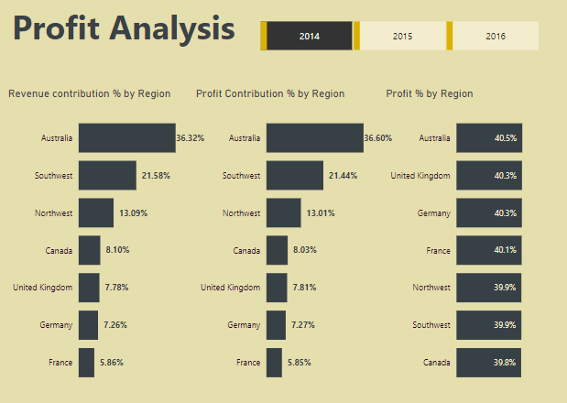
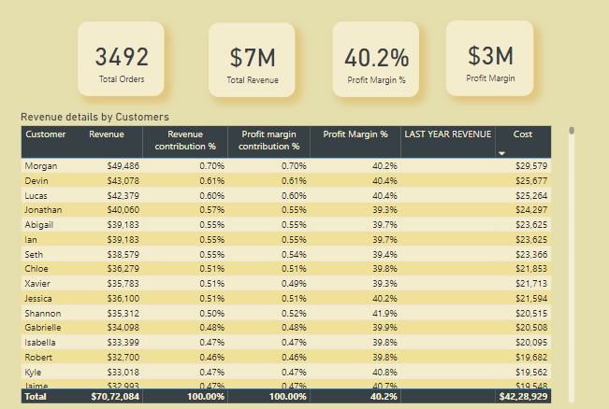
Designed Visuals

Slide 9
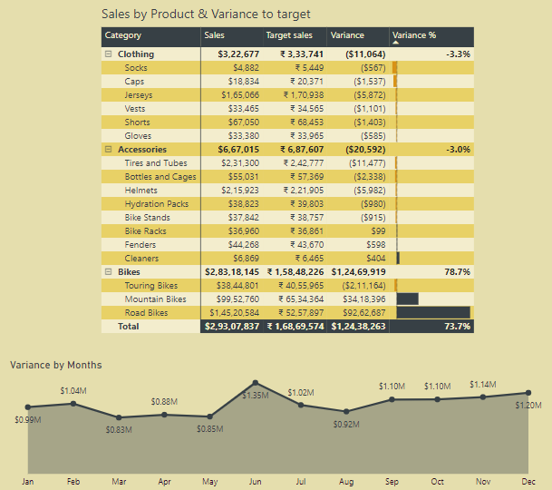
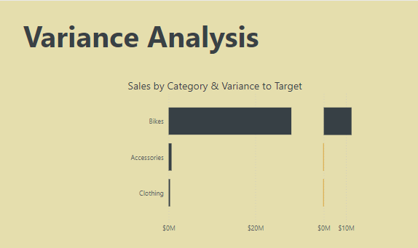
Designed Visuals

Slide 10
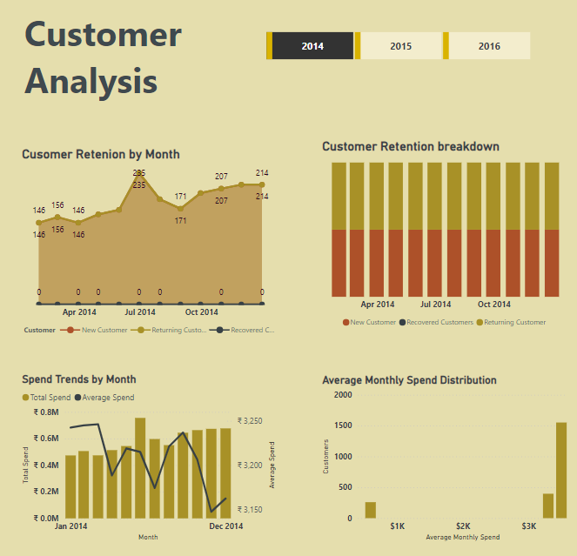
Designed Visuals

Slide 11
Conclusion
Australia boasts the highest and consistently rising profit contribution percentage across the analyzed period.
Profit margins remain steady around 40%, indicating efficient operations across regions.
Based on 2014 data, total sales show a promising year-over-year increase.
Academy Bikes lead product sales in 2014, followed by Mountain Bikes.
Consistently high profit contribution across all three years analyzed.
Profit margins are stable: Hover around 40% year-over-year.
Total sales appear to be increasing year-over-year based on 2014 data.
Academy Bikes lead in sales: Followed by Mountain Bikes in 2014.
Incomplete profitability picture: Lack of data on unit cost and average price hinders assessing profitability by product line.

Slide 12

Thank you
Zeeshan Khan
zk2938560@gmail.com
https://www.linkedin.com/in/zeeshan-khan-72110/
© All images in this presentation have been generated or imagined with the help of AI

